Slide 1
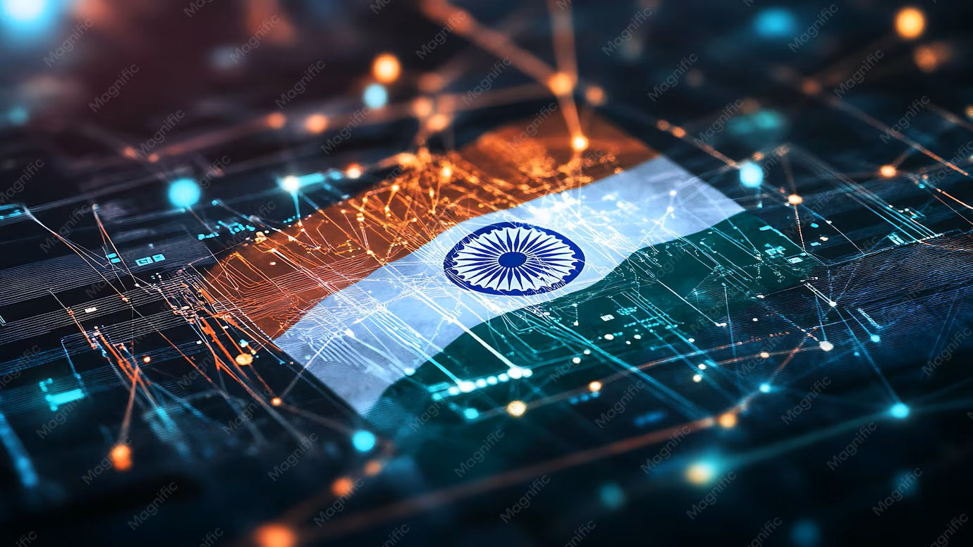

DIGITAL INDIA
Technology for a better future
Presented By:
Name: Deepa
Trade: AIPA
NSTI(W) Allahabad

Slide 2

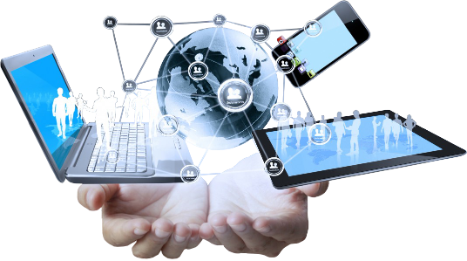
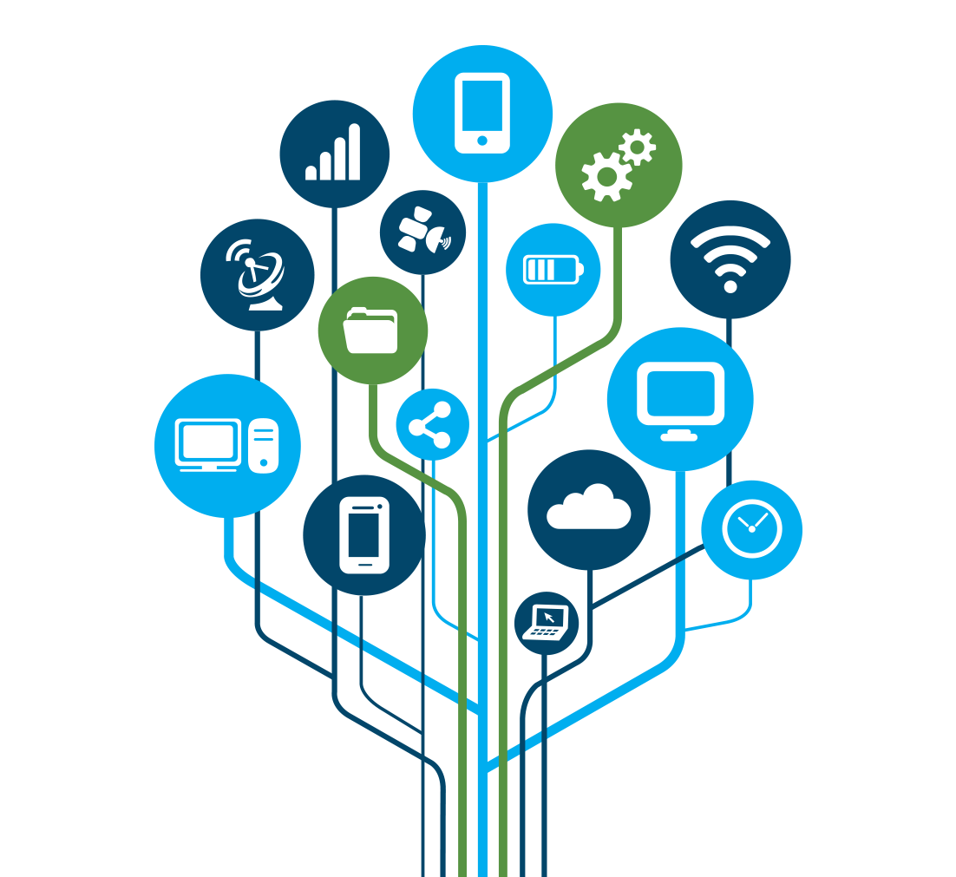
What is Digital India?
Digital India is a government program launched on 1 July 2015.
Its main aim is to make India a digitally empowered society.
It promotes the use of the Internet and digital technology in daily life.
It provides online government services to citizens.
It encourages cashless and digital payments like UPI.

Slide 3
Digital Payment
E-Governance
Digital Education
Digital Healthcare
Online Banking
Digital Infrastructure
Major area of
Digital India

Slide 4
Digital Service We Use
Internet
Mobile
Online
Services
Digital Payment
Digital Certificate

Slide 5
Digital Payment Methode
Payment Methode | Example
UPI | Mobile Payment
Debit Card | Card payment
Credit Card | Online Payment
Not Banking | Bank Transfer
QR Code | Scan & Pay

Slide 6
Growth of Digital Payment
Transaction Index

Slide 7

Benefits Of Digital Technology
Saves Time
Easy Access
Transparency
Convenience
Wider Connectivity

Slide 8
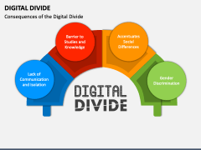
Create a visually attractive diagram showing :
🔐 Cybersecurity
🔒 Data Privacy
🌐 Digital Divide
📱 Digital Literacy
⚠️ Online Fraud

Slide 9
Future Of Digital India
Create a Timeline
Today
Digital Services
Digital Healthcare & Education
Technology-enabled services
5G Connectivity
Faster Communication
Secure Digital India
Safer digital future
Smart Cities
Connected urban services

Slide 10
Conclusion
Digital India is transforming the way people live, work, learn, and connect.
With the growth of Artificial Intelligence, Smart Cities, Digital Payments, and Connected Services, India is moving towards a smarter, more connected, inclusive, and technology-driven future.
The future of Digital India is not just about technology—it is about creating better opportunities and improving the quality of life for everyone.

Slide 11


